Slide 1
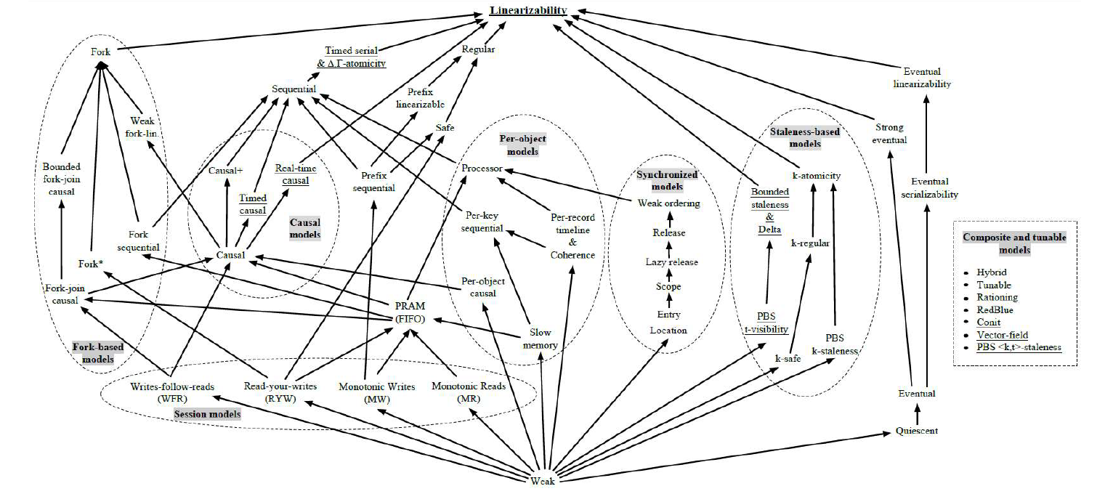
Memory Models

Slide 2
Agenda
Definition
Lamport’s “happened before” relation in shared memory
Examples of memory models
Coherence
Sequential consistency
Causal consistency
Release consistency
Exam questions (if time allows)

Slide 3
Reminder – Memory model
A consistency/memory model is an “agreement” between the execution environment (H/W, OS, middleware) and the processes.
This agreement includes guarantees by the runtime environment to the application, that certain properties of the way values that are written to shared variables become visible to the readers, will hold.
This determines the memory model, what’s valid, what’s not.

Slide 4
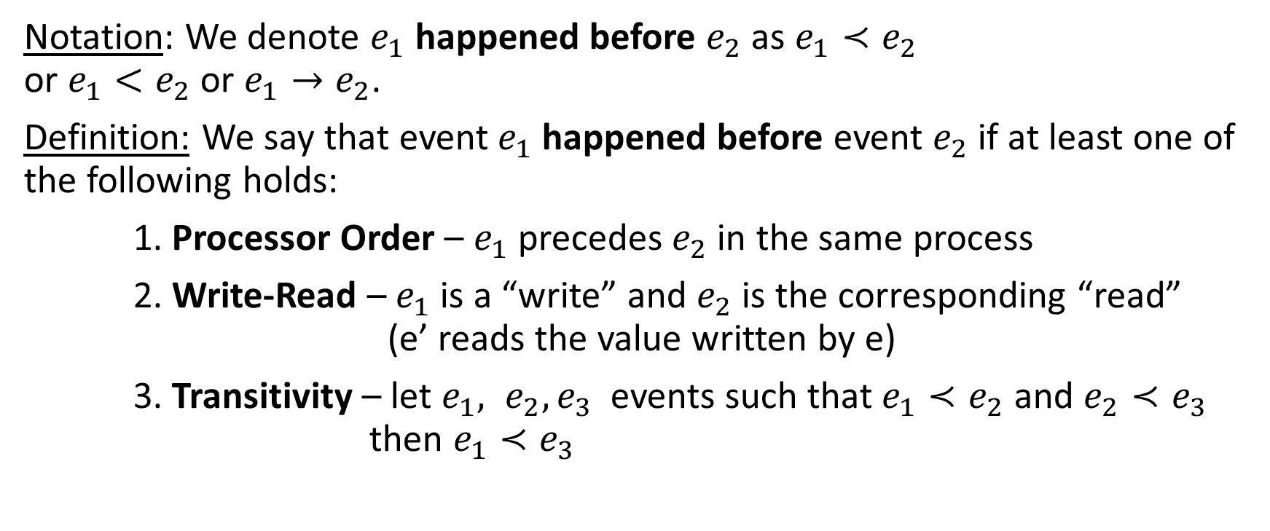
Lamport’s “Happened Before” Relation in Shared Memory
Notation: We denote $e_{1}$ happened before $e_{2}$ as $e_{1}≺e_{2}$ or $e_{1}<e_{2}$ or $e_{1}→e_{2}$.
Definition: We say that event $e_{1}$happened before event $e_{2}$ if at least one of the following holds:
1. Processor Order – $e_{1}$precedes $e_{2}$in the same process
2. Write-Read – $e_{1}$is a “write” and $e_{2}$ is the corresponding “read” (e’ reads the value written by e)
3. Transitivity – let $e_{1}, e_{2}, e_{3}$ events such that $e_{1}≺e_{2}$ and $e_{2}≺e_{3}$ then $e_{1}≺e_{3}$

Slide 5

Independent / concurrent events
We say events $e_{1},e_{2}$ are concurrent or independent if not $e_{1}<e_{2}$ and not $e_{2}<e_{1}.$
We denote independent events $e_{1},e_{2}$ by $e_{1}||e_{2} .$

Slide 6
Lamport’s HB relation in SM - exmplae
global time
P1
W x,1
R y,2
R z,0
W z,4
Program order: R y,2 < W z,4
Write-Read: W y,2 < R y,2
Write-Read: W z,4 < R z,4
Transitivity: W y,2 < R z,4
Concurrent: W z,3 || R x,0
P2
R x,0
R x,1
W y, 2
P3
W z,3
R z,4
(1) Processor Order: e precedes e’ in the same process
(2) Write-Read: e is a write and e’ is the corresponding read (reading the same value)
(3) Transitivity: exists e’’ s.t. e < e’’ and e’’< e’

Slide 7
Coherence
A program P is coherent if for every variable x, there exists an order of read(x)/write(x) which is consistent with program order in all the processes.
Notes:
דגש – זה סדר ביצוע של כל התוכניות ביחד ולא של כל תוכנית בנפרד, וזה לכל משתנה בנפרד.

Slide 8
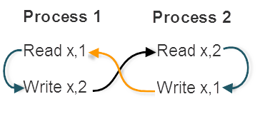
Coherence – Example 1
The execution is not coherent.
There is no order of read(x)/write(x) that is consistent with both process 1 and 2.
(1)
R x,1 < W x,2
(2)
< R x,2
(1)
< W x,1
(3)
=> R x,1 < W x,1
(2)
W x,1 < R x,1
(1) Processor Order: e precedes e’ in the same process
(2) Write-Read: e is a write and e’ is the corresponding read (reading the same value)
(3) Transitivity: exists e’’ s.t. e < e’’ and e’’< e’
A program P is coherent if for every variable x, there exists an order of read(x)/write(x) which is consistent with program order in all the processes.
Notes:
– אם קראנו משהו אז התהליך השני כתב אותו, אבל זה אומר שלפני זה הוא קרא משהו (Program Order), מה שאומר שהתהליך האחר כתב את זה וקיבלנו לולאה – לכן זה לא קוהרנטי.
ההנחה שזה מאותחל או ב0 או בערך לא חוקי

Slide 9
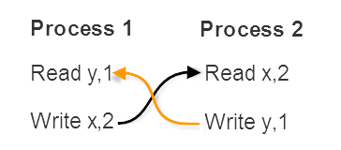
Coherence – Example 2
This execution is coherent.
We found an order of read(x)/write(x) and read(y)/write(y) that is consistent with both process 1 and 2.
For variable x we have: W x,2 < R x,2
For variable y we have: W y,1 < R y,1
(1) Processor Order: e precedes e’ in the same process
(2) Write-Read: e is a write and e’ is the corresponding read (reading the same value)
(3) Transitivity: exists e’’ s.t. e < e’’ and e’’< e’
A program P is coherent if for every variable x, there exists an order of read(x)/write(x) which is consistent with program order in all the processes.

Slide 10
Sequential Consistency
A program P is sequentially consistent if there exists an order of reads/writes (of all the variables) which is consistent with program order in all the processes.
Notes:
הפעם זה לא לכל משתנה בנפרד אלא לכל המשתנים ביחד, וגם לכל התוכניות ביחד. במילים אחרות, קיים סדר ביצוע סדרתי של כל הקריאות וכל הכתיבות של כל התוכניות ביחד.

Slide 11
Sequential Consistency – Example
The execution is not sequentially consistent.
There is no order of read(x)/write(x) that is consistent with both process 1 and 2.
(the same as the first coherent example)
We already verified that this execution is coherent
(1) Processor Order: e precedes e’ in the same process
(2) Write-Read: e is a write and e’ is the corresponding read (reading the same value)
(3) Transitivity: exists e’’ s.t. e < e’’ and e’’< e’
A program P is sequentially consistent if there exists an order of reads/writes (of all the variables) which is consistent with program order in all the processes.
Notes:
In sequential consistency we look at all the reads & writes (of all the variables), which causes new dependencies (the ones on the sides).
The new dependencies prevent us from finding a legal serialization , they close a cycle in the dependencies graph (the same as the first coherent example).

Slide 12
Causal Consistency
Causally related events: Events A and B are causally related if A causes or influences B (A happened before B)
Concurrent events: Events A and B are concurrent/independent if they are not causally related
An execution is said to be legal under causal consistency if writes that are casually related are seen by all processes in the same order. Concurrent writes may be seen/read in a different order on different machines.
Notes:
ביצוע הוא מקיים עקביות סיבתית אם לכל שני אירועי כתיבה E1,E2 אשר מקיימים את יחס הסדר של למפורט, כלל התהליכים רואים את הכתיבות באותו הסדר. אם הקשר הסיבתי בין אירועי כתיבה וקריאה נשמר.
If event B is caused or influenced by an earlier event A (A happened before B), Causal Consistency requires that all the processes first see A, then see B

Slide 13
Causal Consistency – Example 1
P₁ | W₁(x),1 |  |  | W₁(x),3
P₂ |  | R₂(x),1 | W₂(x),2
P₃ |  | R₃(x),1 |  |  | R₃(x),3 | R₃(x),2
P₄ |  | R₄(x),1 |  |  | R₄(x),2 | R₄(x),3
W₁(x),1 → W₂(x),2 and W₁(x),1 → W₁(x),3 are the only writes that are causally related.
W₂(x),2 and W₁(x),3 are concurrent events (so it is not required that all processes see them in the same order).
The above sequence of events is Causally Consistent but not Sequentially Consistent (conflicting readings of x in P3 and P4).

Slide 14
Causal Consistency – Example 2
P₁ | W₁(x),1
P₂ |  | R₂(x),1 | W₂(x),2
P₃ |  |  |  | R₃(x),2 | R₃(x),1
P₄ |  |  |  | R₄(x),1 | R₄(x),2
W₂(x),2 is causally related to W₁(x),1 (because the writing of 2 may result from the value read by R₂(x),1).
Since the two writes are causally related all processes must see them in the same order as they relate each-other, however, P3 sees them in a different order.

Slide 15
Causal Consistency – Example 3
P₁ | W₁(x),1
P₂ |  | W₂(x),2
P₃ |  |  | R₃(x),2 | R₃(x),1
P₄ |  |  | R₄(x),1 | R₄(x),2
W₂(x),2 and W₁(x),1 are concurrent events (the read R₂(x),1 from previous example was removed).
Since the two writes are concurrent they may be seen in a different order by different processes.
Notes:
מקיים Causal Consistency כי אין כתיבות שקשורות קוזאלית

Slide 16
Release Consistency
We say an execution satisfies Release Consistency if the following hold:
Before issuing a write to a memory object or a read from it, the process must acquire the needed lock, and later release it.
Before a read or write access can be performed, all previous acquire accesses must be performed
Before a release access can be performed, all previous read or write accesses must be performed
Acquire and release accesses are sequentially consistent.
Notes:
הנקודה הראשונה – כלל פעולות קריאה וכתיבה על משתנה מתבצעות אך ורק בפרק הזמן בין הרגע בו התהליך נעל את המנעול של אותו משתנה, לרגע בו שחרר את המנעול.
הנקודה השנייה – אין לבצע פעולות קריאה או כתיבה על משתנה לפני נעילת המנעול של אותו משתנה
הנקודה השלישית – אין לבצע פעולות קריאה או כתיבה על משתנה לאחר שחרור המנעול על אותו משתנה
הנקודה הרביעית – יש סדר אחד מוסכם בין כל התהליכים על הנעילות של כל המשתנים – כלומר בכל רגע ברור לכולם מי נעל מה.

Slide 17
Release Consistency - Question
Event e is considered happened before event e’ according to Release consistency. Write the 3 conditions that define this formally:
Answer:
1) Processor Order: e precedes e’ in the same process (thread).
2) Release-Acquire: e is a release and e’ is the following acquire of the same lock.
3) Transitivity: there exists e’’ s.t. e < e’’ and e’’< e’

Slide 18
Exam Question 1 (1)
Given the following execution of a program with 4 threads:
Is the execution coherent?
If no explain, if yes give an execution order for X and Y writes.
P1: R X,7; R Y,17; R X,13; R Y,11
P2: W X,7; W Y,11; R X,7; R Y,11
P3: W X,13; W Y,17
P4: R Y,11; R X,13
Notes:
To answer the question, we have to look at writes/reads for each variable separately, and try to find an order that is consistent with their order in every thread.
In this program there are two variables X and Y, for every one of them we will try to find an order of the commands relating to it, which is consistent with P1, P2, P3 and P4 program orders.

Slide 19
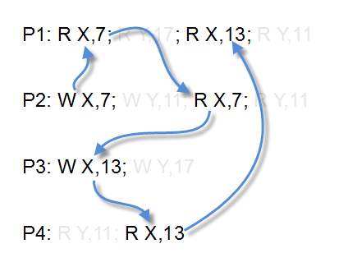
Exam Question 1 (2)
For commands relating to X we suggest the following order:
Then we can order the writes to X in the following order:
W X,7; W X,13;

Slide 20
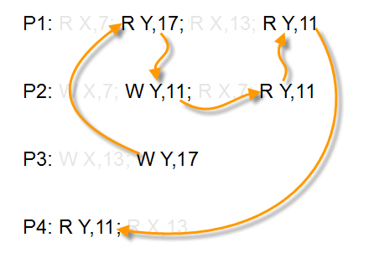
Exam Question 1 (3)
For commands relating to Y we suggest the following order:
Then we can order the writes to Y as the following:
W Y,17; W Y,11;
For each one of the variables X and Y we found a working commands order; therefore the execution is coherent.

Slide 21
Exam Question 2 (1)
Given the following execution of a program with 4 threads:
Is the execution sequentially consistent?
If no explain, if yes give an execution order for X and Y writes.
P1: R X,7; R Y,17; R X,13; R Y,11
P2: W X,7; W Y,11; R X,7; R Y,11
P3: W X,13; W Y,17
P4: R Y,11; R X,13
Notes:
Same execution as before but now we look on sequential consistency.

Slide 22
Exam Question 2 (2)
P1: R X,7; R Y,17; R X,13; R Y,11
P2: W X,7; W Y,11; R X,7; R Y,11
P3: W X,13; W Y,17
P4: R Y,11; R X,13
(P3)
W X,13 < W Y,17
(1)
< W Y,11
(P2)
< R X,7
(2)
< W X,13
(1) According to P1: R Y,17 < R Y,11 (P1 Order)
=> W Y,17 < W Y,11
=> W X,7 < W X,13
(2) According to P1: R X,7 < R X,13 (P1 Order)
=> W X,7 < R X,7 < W X,13 (no other writes)
Notes:
The execution is sequentially consistent if we can order all the read/write commands (of all the variables together) that is consistent with all the program orders of the threads.
For sequential consistency, the happened before relation is not enough.
This is a NP hard problem.

Slide 23
Exam Question 2 (2)
P1: R X,7; R Y,17; R X,13; R Y,11
P2: W X,7; W Y,11; R X,7; R Y,11
P3: W X,13; W Y,17
P4: R Y,11; R X,13
(P3)
W X,13 < W Y,17
(1)
< W Y,11
(P2)
< R X,7
(2)
< W X,13
(1) According to P1: R Y,17 < R Y,11 (P1 Order)
=> W Y,17 < W Y,11
=> W X,7 < W X,13
(2) According to P1: R X,7 < R X,13 (P1 Order)
=> W X,7 < R X,7 < W X,13 (no other writes)
Notes:
The execution is sequentially consistent if we can order all the read/write commands (of all the variables together) that is consistent with all the program orders of the threads.
For sequential consistency, the happened before relation is not enough.
This is a NP hard problem.
Lemma 1: if R x,a < R x,b => W x,a < W x,b
Lemma 2: if W x,a < W x,b => R x,a < W x,b

Slide 24
Exam Question 3 (1)
Given the following execution of a program with 4 threads:
Is the execution causally consistent?
If no explain, if yes give an execution order for X and Y writes.
P1: R X,7; R Y,17; R X,13; R Y,11
P2: W X,7; W Y,11; R X,7; R Y,11
P3: W X,13; W Y,17
P4: R Y,11; R X,13

Slide 25
Exam Question 3 (2)
P1: R X,7; R Y,17; R X,13; R Y,11;
P2: W X,7; W Y,11; R X,7; R Y,11;
P3: W X,13; W Y,17;
P4: R Y,11; R X,13;
R X,7;
We can order the causally related command such that reads come after the write they are related to
There is no other causal relations in this program
This defines a partial order, but that is what causally consistent requires in our case
For every group of related commands, the order must be seen the same for all the processes
Notes:
The order of the causally related writes: { W X,7; W Y,11 }, { W X,13; W Y,17 {
How can we add a conflict by adding a read to P4? Ans: R X, 7

Slide 26
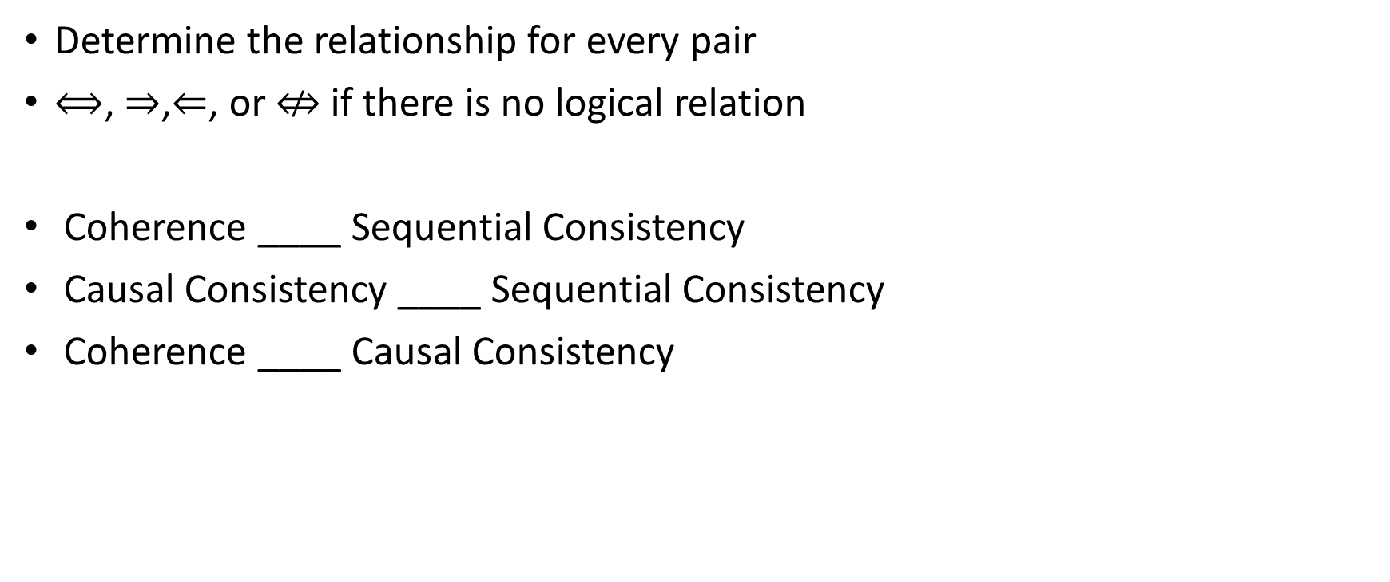
Exam Question 4 (1)
Determine the relationship for every pair
$⟺$, $⇒$,$⇐$, or $⇎$ if there is no logical relation
Coherence ____ Sequential Consistency
Causal Consistency ____ Sequential Consistency
Coherence ____ Causal Consistency

Slide 27
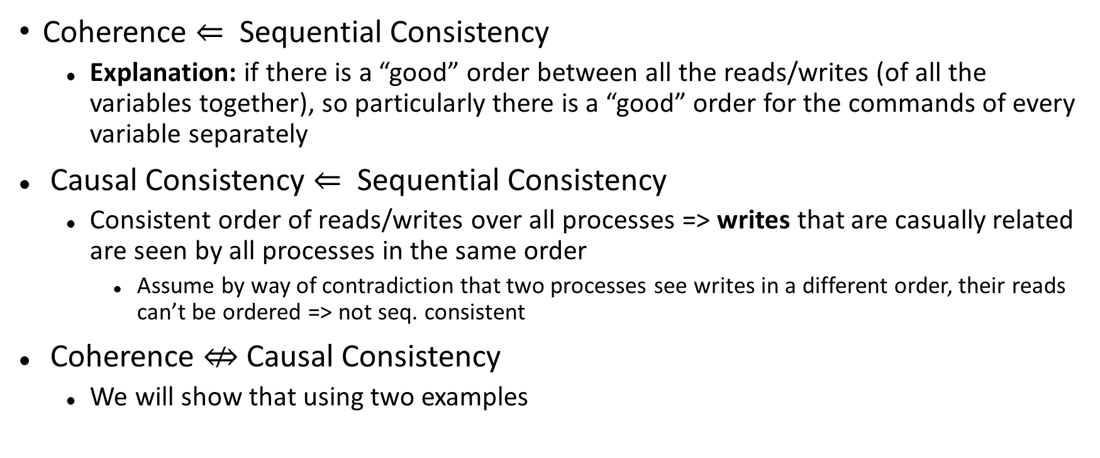
Exam Question 4 (2)
Coherence $⇐$ Sequential Consistency
Explanation: if there is a “good” order between all the reads/writes (of all the variables together), so particularly there is a “good” order for the commands of every variable separately
Causal Consistency $⇐$ Sequential Consistency
Consistent order of reads/writes over all processes => writes that are casually related are seen by all processes in the same order
Assume by way of contradiction that two processes see writes in a different order, their reads can’t be ordered => not seq. consistent
Coherence $⇎$ Causal Consistency
We will show that using two examples

Slide 28
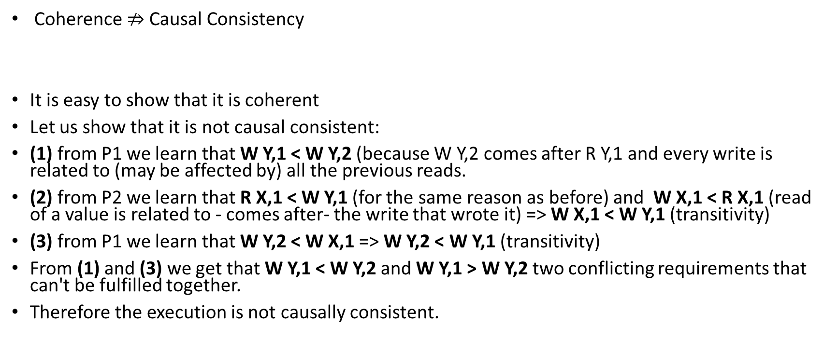
Exam Question 4 (3)
Coherence $⇏$Causal Consistency
It is easy to show that it is coherent
Let us show that it is not causal consistent:
(1) from P1 we learn that W Y,1 < W Y,2 (because W Y,2 comes after R Y,1 and every write is related to (may be affected by) all the previous reads.
(2) from P2 we learn that R X,1 < W Y,1 (for the same reason as before) and W X,1 < R X,1 (read of a value is related to - comes after- the write that wrote it) => W X,1 < W Y,1 (transitivity)
(3) from P1 we learn that W Y,2 < W X,1 => W Y,2 < W Y,1 (transitivity)
From (1) and (3) we get that W Y,1 < W Y,2 and W Y,1 > W Y,2 two conflicting requirements that can't be fulfilled together.
Therefore the execution is not causally consistent.
P1: R Y,1; W Y,2; R Y,2; W X,1;
P2: R X,1; W Y,1; R Y,2;

Slide 29
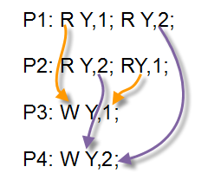
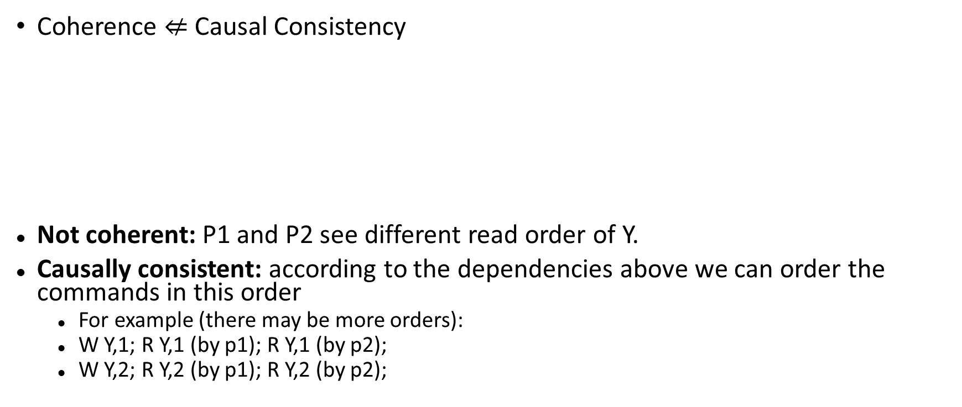
Exam Question 4 (4)
Coherence $⇍$ Causal Consistency
Not coherent: P1 and P2 see different read order of Y.
Causally consistent: according to the dependencies above we can order the commands in this order
For example (there may be more orders):
W Y,1; R Y,1 (by p1); R Y,1 (by p2);
W Y,2; R Y,2 (by p1); R Y,2 (by p2);
Notes:
Coherence: Invert arrows for happened-before relation, choose an order of writes (1, 2 or 2, 1), in both cases there’s a dependency circle

Slide 30
Exam Question 5 (1)
Given that Java's lock-free memory model obeys Coherence, what values of a,b are possible after the following execution:
Initialization: int a = 1, b = 2;
After the initializations, both threads are running in parallel
Note: in this question there can be more than one right answer (mark them all).
A. a = 1; b = 2;
B. a = 2; b = 1;
C. a = 1; b = 1;
Thread A: a = b; | Thread B: b = a;
Notes:
For extra reading, Java’s memory model is a bit stronger than coherence: http://www.cs.umd.edu/~pugh/java/latex2html/jmm/node2.html

Slide 31
Exam Question 5 (2)
Option A: a = 1; b = 2;
Initialization: int a = 1, b = 2;
Thread B: b = a; | Thread A: a = b;
R a, 2 | R b, 1
W b, 2 | W a, 1
W b,1 does not exist!

Slide 32
Exam Question 5 (3)
Option B: a = 2; b = 1;
Initialization: int a = 1, b = 2;
Thread B: b = a; | Thread A: a = b;
R a, 1 | R b, 2
W b, 1 | W a, 2
Full order of reads and writes
= > Sequential Consistency

Slide 33
Exam Question 5 (4)
Option C: a = 1; b = 1;
Initialization: int a = 1, b = 2;
Thread B: b = a; | Thread A: a = b;
R a, 1 | R b, 1
W b, 1 | W a, 1
Full order of reads and writes
= > Sequential Consistency

